Slide 1

Insurance Management
Project By:
Smit Patel.
Saloni Mathur.
Richa Shah.
Date: 08/08/2022

Slide 2
Introduction:
To build a web system that can manage insurance payments and allows users to sign up for insurances falling under two categories, i.e., health and home insurance.
The home insurance will calculate premium based on what the location of the house is.
The health insurance part will include insurance plans, premium structure and a list of illnesses and hospitals.

Slide 3
Approach:
Understanding the problem statement.
Building ER Diagram and building the database.
Building the backend to fetch the data from database
Built an API in spring to communicate between database using Spring Boot.
Built the UI with angular that will show all the required data.

Slide 4
TechStack:
SQL Queries
Spring Boot
RestAPI
Java
Angular
Tailwind CSS

Slide 5
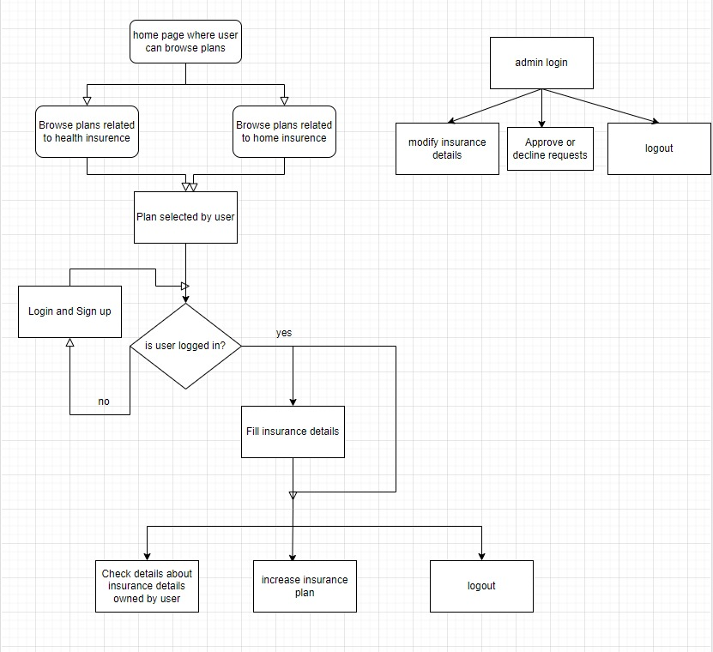
Working Flow:

Slide 6
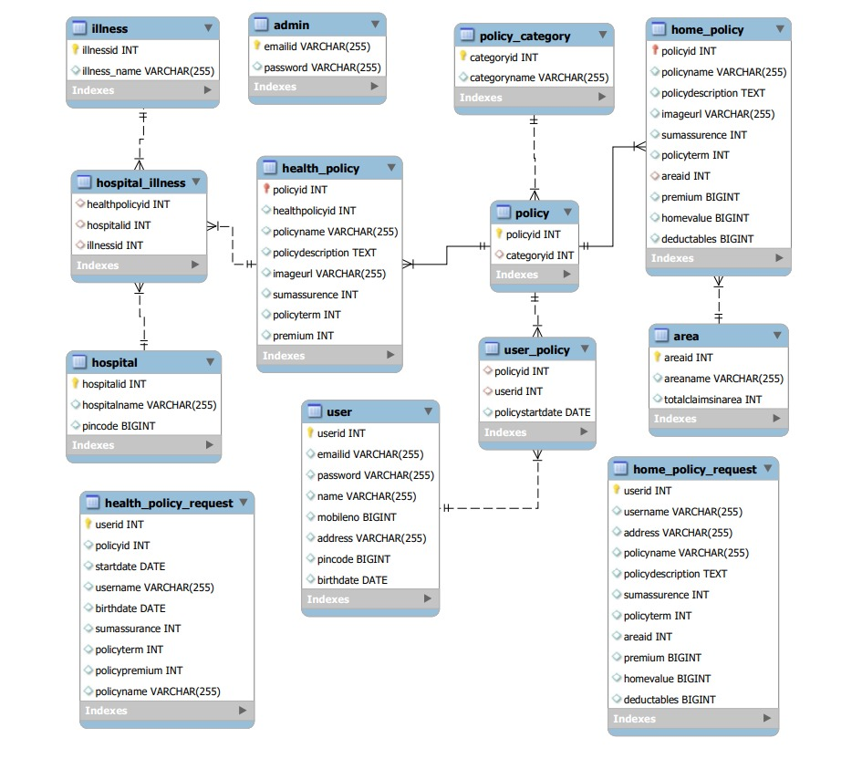
DataBase: ER Diagram

Slide 7
Learnings:
Learnt how to design the database according to the given problem statement.
Learnt how to use all the technologies in real-time problems.
Learnt how to test APIs using Postman.
Learnt how to use Auth-Guard.

Slide 8
Challenges:
To achieve connections between two or more tables.
Communicating between components.
Achieving relation from the database in API.
Design decisions.
Connection between Angular and Spring Boot.

Slide 9
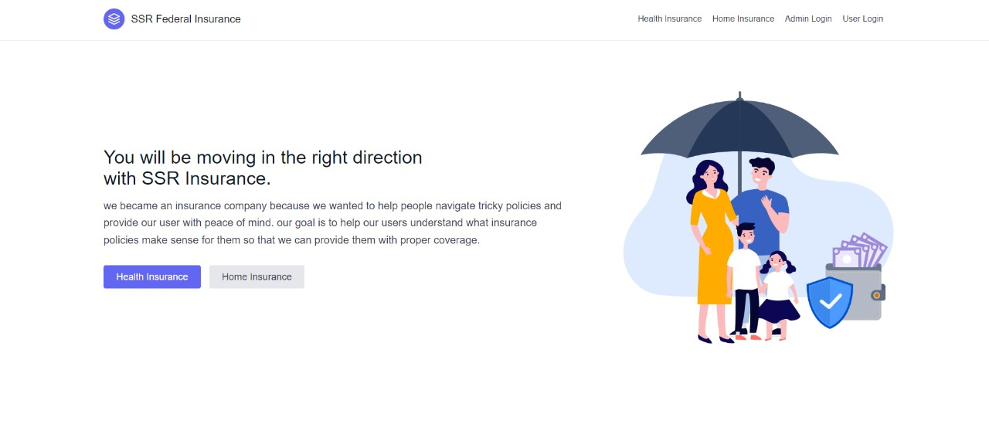
UI(Homepage):

Slide 10
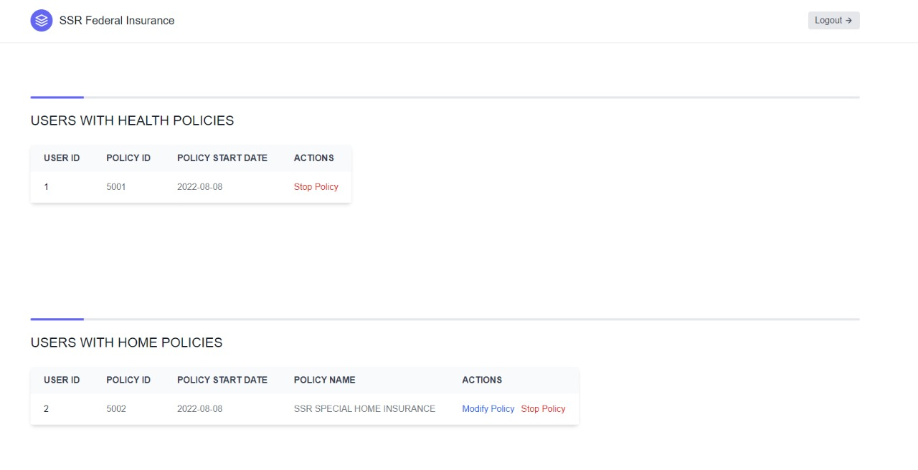
UI(Policies):

Slide 11
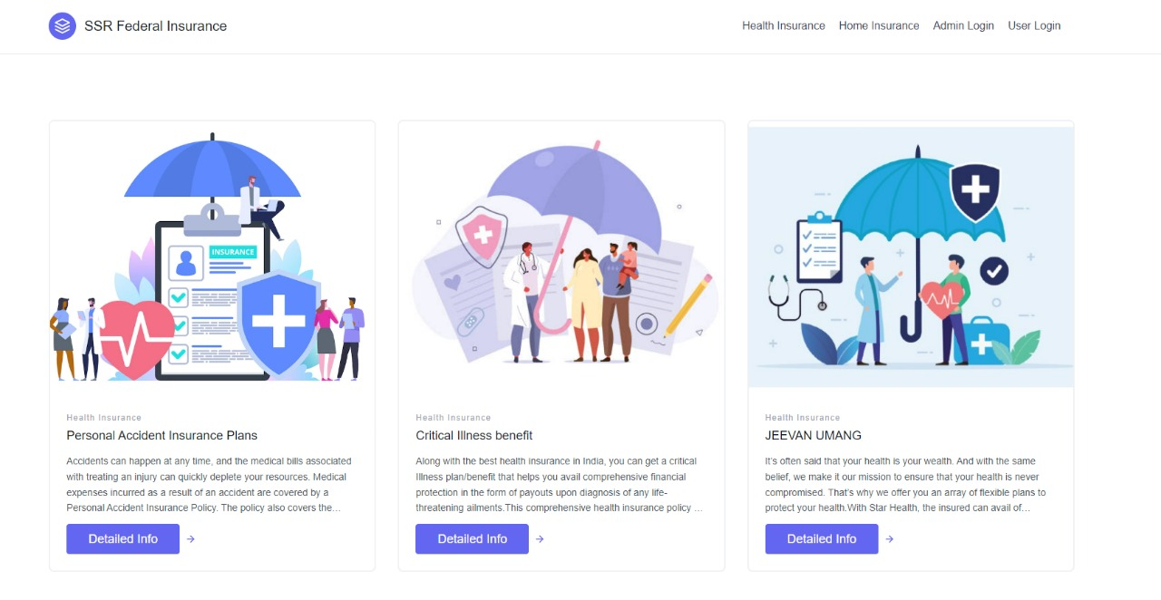
UI(Health homepage):

Slide 12
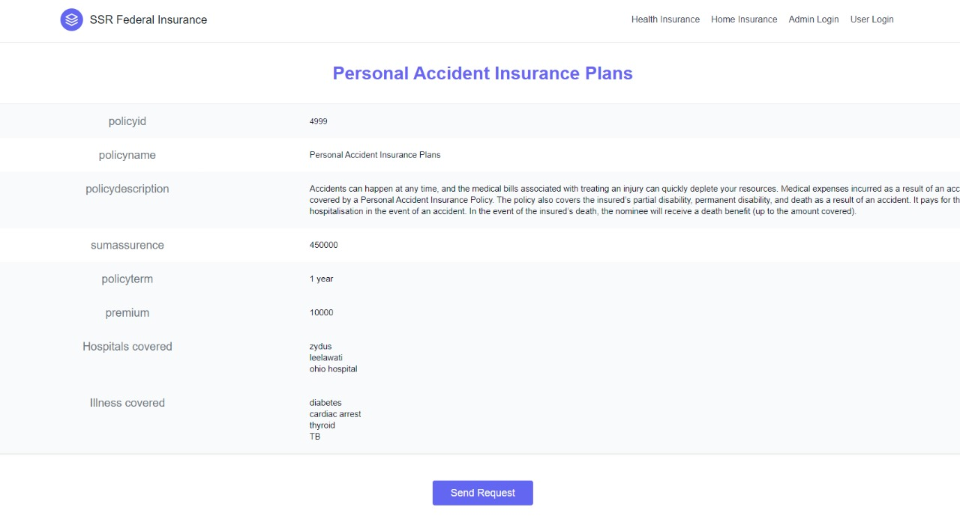
UI(health):

Slide 13
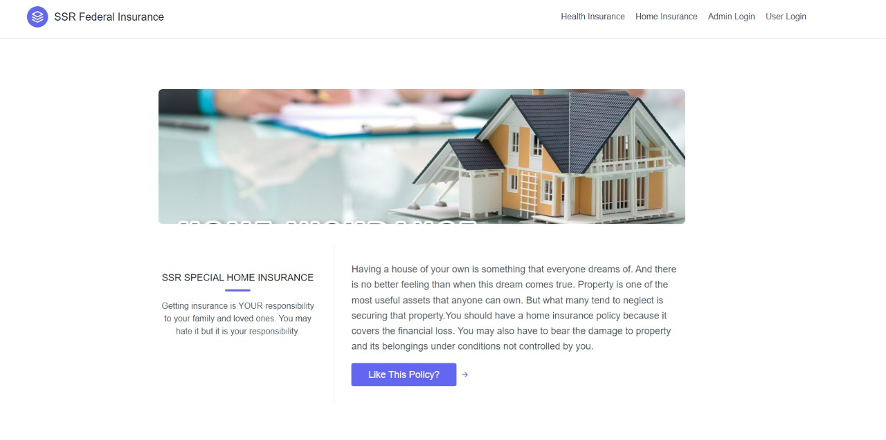
UI(Home Policy):

Slide 14
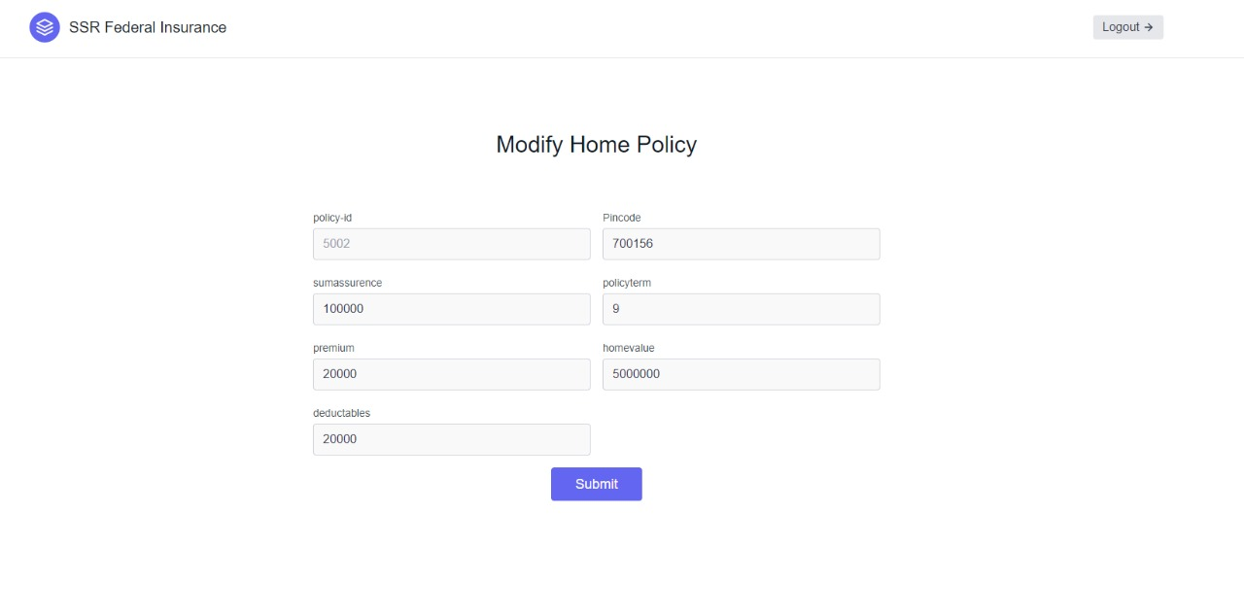
UI:

Slide 15


